Slide 1
Topic 1.3 – Introduction to Bonding
Unit 1

Slide 2
Vocab List
Covalent
Metallic
Electrons
Valence
Ionic
Ionic Compounds
Lewis Diagram
Monoatomic
Polyatomic
Metals
Non-metals
Cations
Anions
Electronegativity
Crystalline lattice

Slide 3
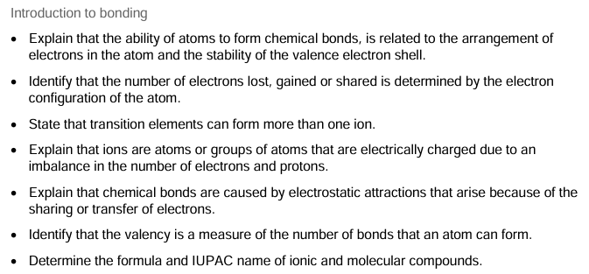
Learning Goal

Slide 4
Types of bonds
Type of Bond | Occurs between | Description
Covalent | Non-metals | electrons shared between atoms.
Ionic | Metals ionically bonded to non-metals | atoms that have lost / gained electrons experience electrostatic attraction to each other.
Metallic | Metals | electrons shared amongst a lattice of metal cations.

Slide 5
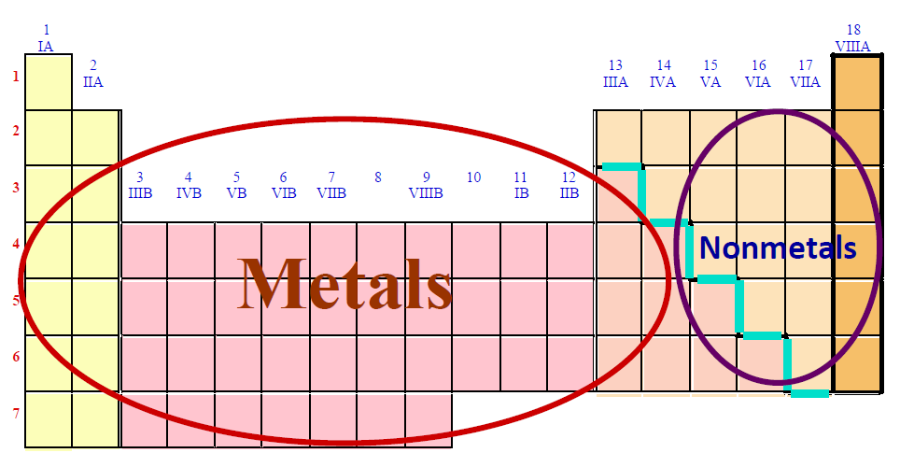
Remember…

Slide 6
Naming conventions – ionic compounds
1) Name the cation first, followed by the anion.
2) Use an appropriate suffix for the anion.
Suffixes -ide – Element only -ite – Polyatomic ions with some oxygen -ate – Polyatomic ions with more oxygen
3) Transition metals can have different ionic charges. The ionic charge needs to be specified in the name for these atoms only.
e.g. Iron (III) oxide indicates that iron has a +3 charge in this compound.

Slide 7
Example – name
MgCO₃
Cation = magnesium
Anion = carbonate
1) Name the cation first, followed by the anion.
2) Use an appropriate suffix for the anion.
Suffixes -ide – Element only -ite – Polyatomic ions with some oxygen -ate – Polyatomic ions with more oxygen
3) Transition metals can have different ionic charges. The ionic charge needs to be specified in the name for these atoms only.
magnesium carbonate
There are no transition metals in this compound ☺

Slide 8
Your turn
1) Name the following ionic compounds:
(a) NaBr = Sodium Bromide
(b) CaO = Calcium Oxide
(c) Al₂O₃ = Aluminium Oxide
(d) CuCl₂ = Copper (II) Chloride

Slide 9
Why do bonds form?
Think back to the atomic structure and electron configuration.

Slide 10
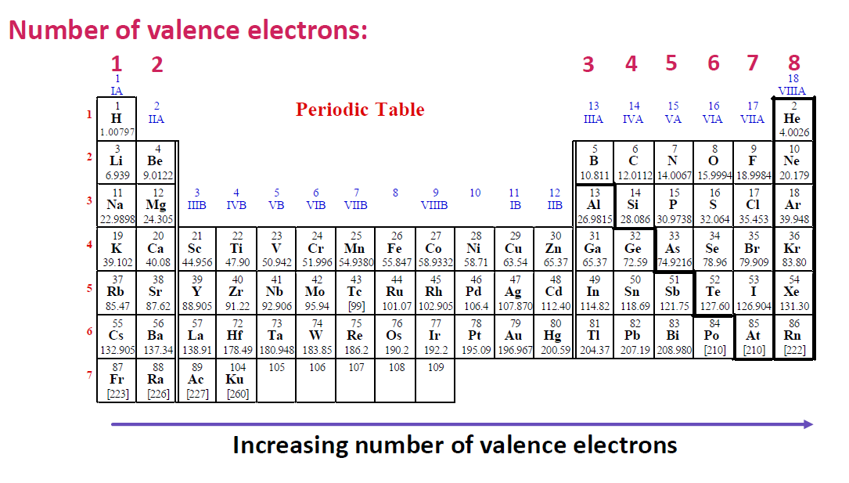
Working out ionic charges

Slide 11
Working out ionic charges
+1
+2
+3
±4
-3
-2
-1
Transition metals - Variable

Slide 12
Polyatomic ions – memorise
Polyatomic Ion | Formula
Ammonium | NH₄⁺
Carbonate | CO₃²⁻
Chromate | CrO₄²⁻
Cyanide | CN⁻
Dihydrogenphosphate | H₂PO₄⁻
Hydronium | H₃O⁺
Hydroxide | OH⁻
Hypochlorite | ClO⁻
Nitrate | NO₃⁻
Nitrite | NO₂⁻
Perchlorate | ClO₄⁻
Permanganate | MnO₄²⁻
Phosphate | PO₄³⁻
Sulfate | SO₄²⁻
Sulfite | SO₃²⁻

Slide 13
Transition metals…
Transition metals can form a range of ions with different charges. Predicting how transition metal elements will form ions is not easy.
You will always be told the charge of a transition metal ion, or you will be able to work it out from the charges of other ions in the ionic compound.
Transition metals exhibit this behaviour thanks to the partially filled d-orbitals.
Let’s use iron as an example.

Slide 14
Transition metals – iron
1) Determine the electron configuration of iron (Atomic number 26).
2) Identify the valence electrons in iron.
3) Iron can form both iron (II) and iron (III) cations. Use the electron configuration of iron to explain why this is possible.

Slide 15
Ionic formulae
To determine the molecular formula of an ionic compound:
Identify the ions in the compound (chemical symbol and charge).
Use the criss-cross method to determine the simplest ratio of ions.
Write the chemical formula using the correct chemical symbols and the simplest ratio as the subscripts.
Check that the ionic compound has a neutral charge (charge = 0).

Slide 16
Example – Hydrogen sulfide

Slide 17
Example – Magnesium oxide
Mg²⁺ O²⁻
Mg₂ O₂
MgO

Slide 18
Example – sodium carbonate
Na⁺ CO₃²⁻
Na₂CO₃

Slide 19
Example – Magnesium Hydroxide
Mg²⁺ OH⁻
Mg(OH)₂

Slide 20
Check your understanding
1) Explain why the magnesium ion has a 2+ charge whereas the aluminium ion has a +3 charge. Refer to the electron configuration in your response.
2) A claim was made that nitrogen always forms three bonds. State whether you agree / disagree with this claim. Justify your answer with reference to the electronic configuration of nitrogen.

Slide 21
Check your understanding
Determine the molecular formulas for the following ionic compounds:
(a) Copper (II) chloride
(b) Lithium hydroxide
(c) Calcium iodide
Determine the IUPAC name of the following ionic compounds:
(d) BeCl₂
(e) MgCO₃
(f) Fe(OH)₃

Slide 22
Check your understanding
Determine the balanced chemical equation for the following reactions:
Sodium hydroxide is dissolved into a copper (II) chloride solution. This reaction forms copper (II) hydroxide, which is a blue solid, and sodium chloride in solution.

